Slide 1
Section 5.2
Integration: “The Indefinite Integral”

Slide 2
All graphics are attributed to:
Calculus,10/E by Howard Anton, Irl Bivens, and Stephen Davis
Copyright © 2009 by John Wiley & Sons, Inc. All rights reserved.

Slide 3

Introduction
In the last section we saw how antidifferentiation could be used to find exact areas. In this section we will develop some fundamental results about antidifferentiation.
For example, F(x) = 1/3 x³ is an antiderivative “F” of f(x) = x² because the derivative of F(x) is F’(x) = x² = f(x).
The problem is that F(x) = 1/3 x³ is not the ONLY antiderivative of f(x).

Slide 4
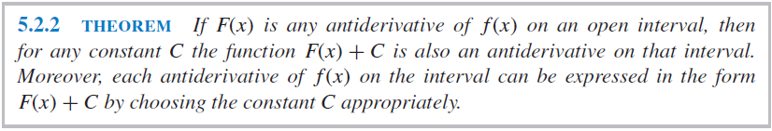
The Problem with the Previous Example
If we add any constant C to 1/3 x³ , then the function G(x) = 1/3 x³ + C is also an antiderivative of f(x) since the derivative of G(x) is G’(x)= x² + 0 = f(x)
For example, take the derivatives of the following: F(x) = 1/3 x³ - 5, F(x) = 1/3 x³ +1/4, F(x) = 1/3 x³ +1, F(x) = 1/3 x³ +7, etc.

Slide 5


The Indefinite Integral
The process of finding antiderivatives is called antidifferentiation or integration.
Since F’(x) = f(x), when we go backwards means the same thing.
For a more specific example:
The integral of f(x) with respect to x is equal to F(x) plus a constant.

Slide 6
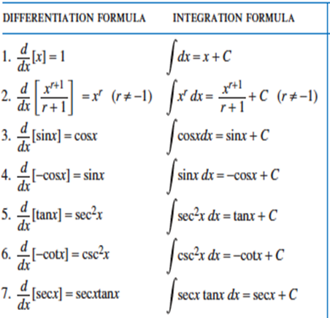
Integration Formulas
Here are some examples of derivative formulas and their equivalent integration formulas:
The integration
formula is just
“backwards”
when compared to
the derivative
formula you know.

Slide 7
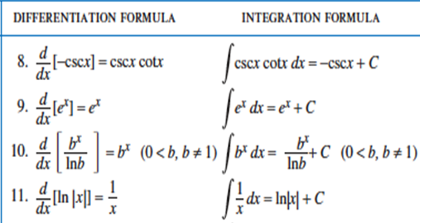
Integration Formulas
Here are more examples of derivative formulas and their equivalent integration formulas:
When you need to refer
back to these (you
probably will need to
quite often), you will
find the list on pg 324.
You might want to mark
it with a post-it.

Slide 8
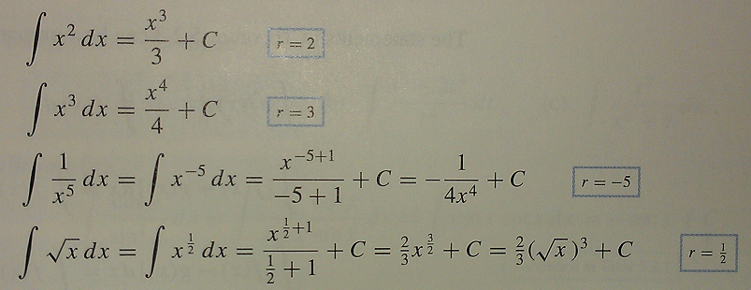
Examples
Here are some common examples to follow when integrating x raised to a power other than -1.
Remember: To integrate a power of x, add 1 to the exponent and divide by the new exponent.

Slide 9



Properties of the Indefinite Integral
Our first properties of antiderivatives (integrals) follow directly from the simple constant factor, sum, and difference rules for limits and derivatives:
1.
2.
3.

Slide 10
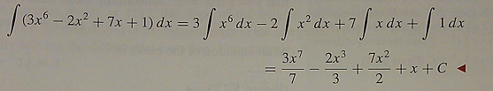
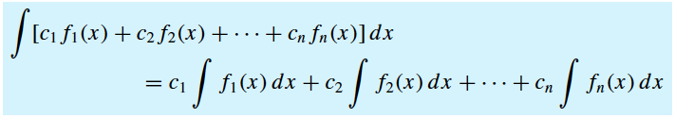
Combining Those Properties
We can combine those three properties for combinations of sums, differences, and/or multiples of constants.
Example:
General Rule:

Slide 11
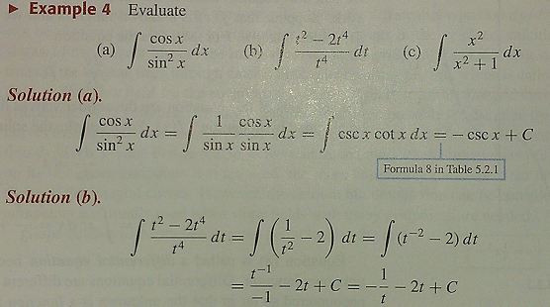
Consider Simplifying First
Sometimes it is useful to rewrite an integrand (the thing you are taking the integral of) in a different form before performing the integration.
Examples:

Slide 12
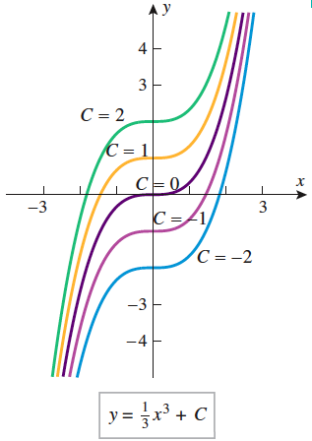
Integral Curves
As we discussed on slide #4, any of these curves could be the integral (antiderivative) of f(x) = x² because we do not know what the value of C is.

Slide 13
Initial Condition
When an “initial condition” is introduced, such as a requirement that the graph pass through a certain point, we may then solve for C and find the specific integral.
Example: Instead of finding that the integral of f(x) = x² is F(x) = 1/3 x³ + C, if we were given that the graph passes through the point (2,1) we could solve for C: 1 = 1/3 (2)³ + C
This gives us 1=8/3 + C so C=-5/3 and our anti-derivative is more specific:
F(x)=1/3 x³ -5/3

Slide 14
Slope Fields
If we interpret dy/dx as the slope of a tangent line, then at a point (x,y) on an integral curve of the equation dy/dx=f(x), the slope of the tangent line is f(x).
We can find the slopes of the tangent lines by doing repeated substitution and drawing small portions of the tangent lines through those points.
The resulting picture is called a slope field and it shows the “direction” of the integral curves at the gridpoints.
We can do it by hand, but it is a lot of work and it is more commonly done by computer.

Slide 15
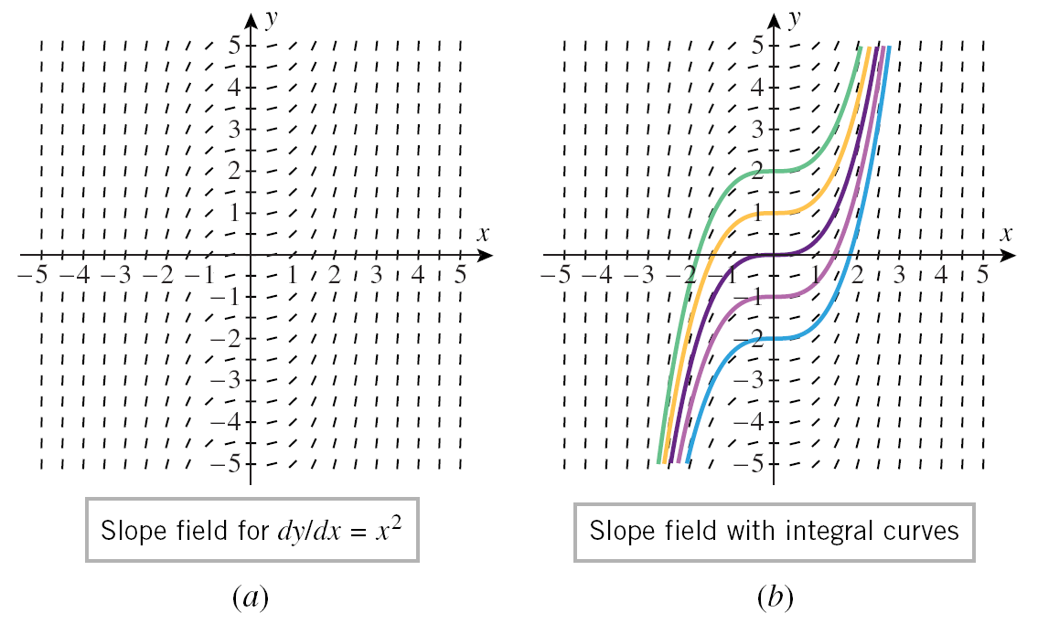
Example

Slide 16

I love the Eiffel Tower

